Slide 1
AGENDA
INSTALLATION
EF CORE
MIGRATION
LINKS

Slide 2
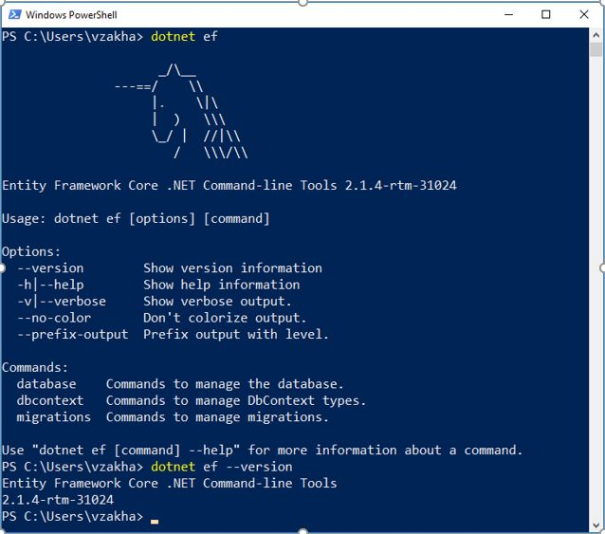
INSTALLATION
NuGet packages
•Microsoft.EntityFrameworkCore.SqlServer
•Microsoft.EntityFrameworkCore.Tools
Installing packages
•dotnet add package (console)
•Install-Package (VS terminal)

Slide 3
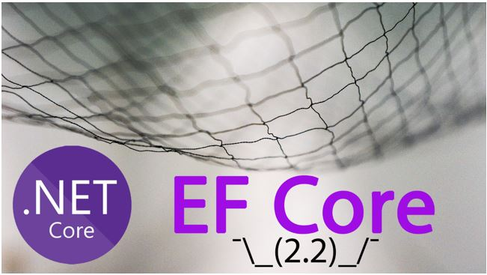
EF Core
Database drivers:
SQL Server
SQLite
PostgreSQL

Slide 4
MIGRATIONS
EF core provides simple way of keeping your EF core model and database schema in sync.
EF core model (Migrations)
Database schema (Reverse Engineering)
1. Add-Migration InitialCreate
2. Update-Database
Script-Migration
1. Remove-Migration
2. Update-Database
Update-Database<name>

Slide 5
LINKS
Manual
https://metanit.com/sharp/entityframeworkcore/
https://docs.microsoft.com/en-us/ef/core/managing-schemas/migrations/
Examples
•https://www.youtube.com/watch?v=zHdzpO24EbY
•https://www.youtube.com/watch?v=RrOPUegE8MI
•https://www.youtube.com/watch?v=Gbhlo_Q4VXo&t=77s

